Slide 1
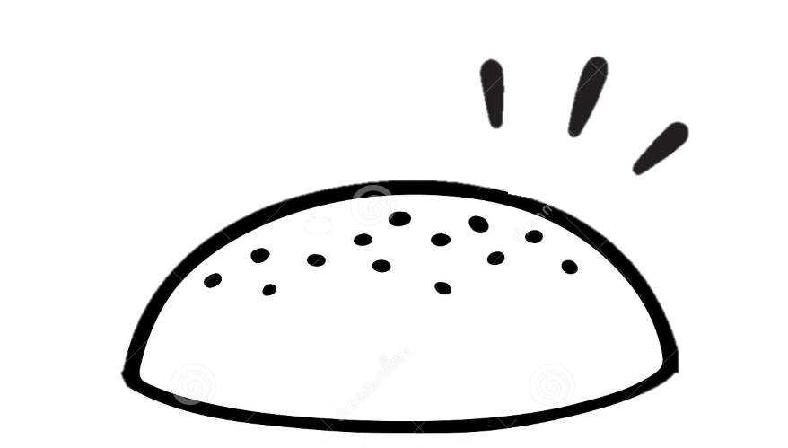

MUNCH MANAGER

Slide 2

Problem
Significantly reduce food waste at retail or consumer level.
Indication of proximity to food wastage.

Slide 3
Solution
Munch Management optimises food providers efficiency by:
Closing Feedback Loop
Improving Menu Offerings
Prediction of Food Demand

Slide 4
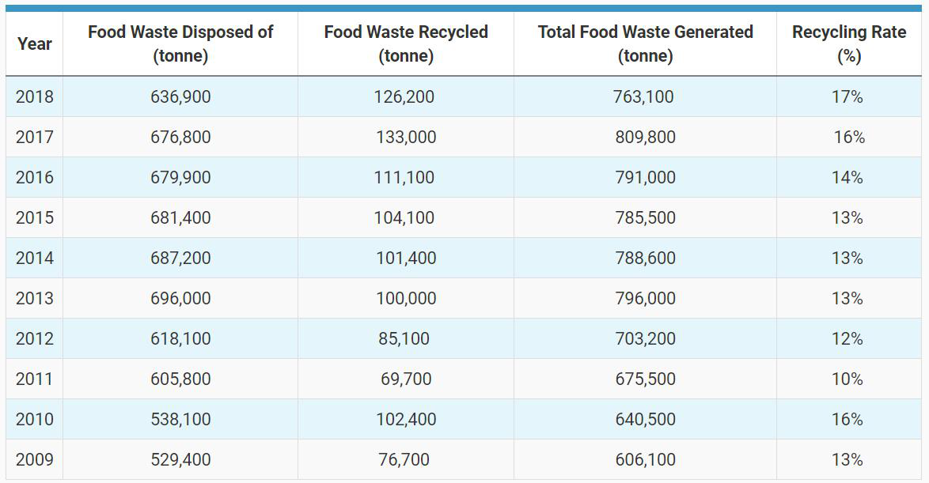
FOOD WASTAGE IN SINGAPORE

Slide 5
FOOD WASTAGE IN SAF
One of the largest logistical organization in Singapore
1
2
3
Food portions are too much and poor quality of food
results in large amount of food wastage
Food wastage viewed as a
“normal affair”
Feedback loop is manipulated
and not targeted

Slide 6



Military Man
SOLUTION
SPACE
Canteen
Supervisor
Senior Management

Slide 7





IT Solution Architecture
Food Feedback Form
Food Choice Voting System
1
2
Weight of Food Wastage
Food Choice Preferences
Food Satisfaction Feedback
1
2

Slide 8
FEATURES
FOOD DEMAND PREDICTION
USER PROFILING
FEEDBACK
MAP
Time Series Prediction
How much to order?
How much to cook?
K-Nearest Neighbours Clustering
What to cook?
Market Basket Analysis |
Linear Regression
What are the problematic food items?
Identify Groupings
Visualization of Food Wastage
Where is the problem?
Where are my learning avenues?

Slide 9
1
2
3
Raise awareness of food wastage among Servicemen and Servicewomen
Tastier food increases morale, care for soldiers
Accountability for organization
ADDITIONAL BENEFITS

Slide 10
TECH DEMO

Slide 11


CONCLUSION
Government organization should lead the charge in reducing waste
Adoption is enforced and guaranteed
Private organizations can build apps on top of API

Slide 12
Q & A

Slide 13
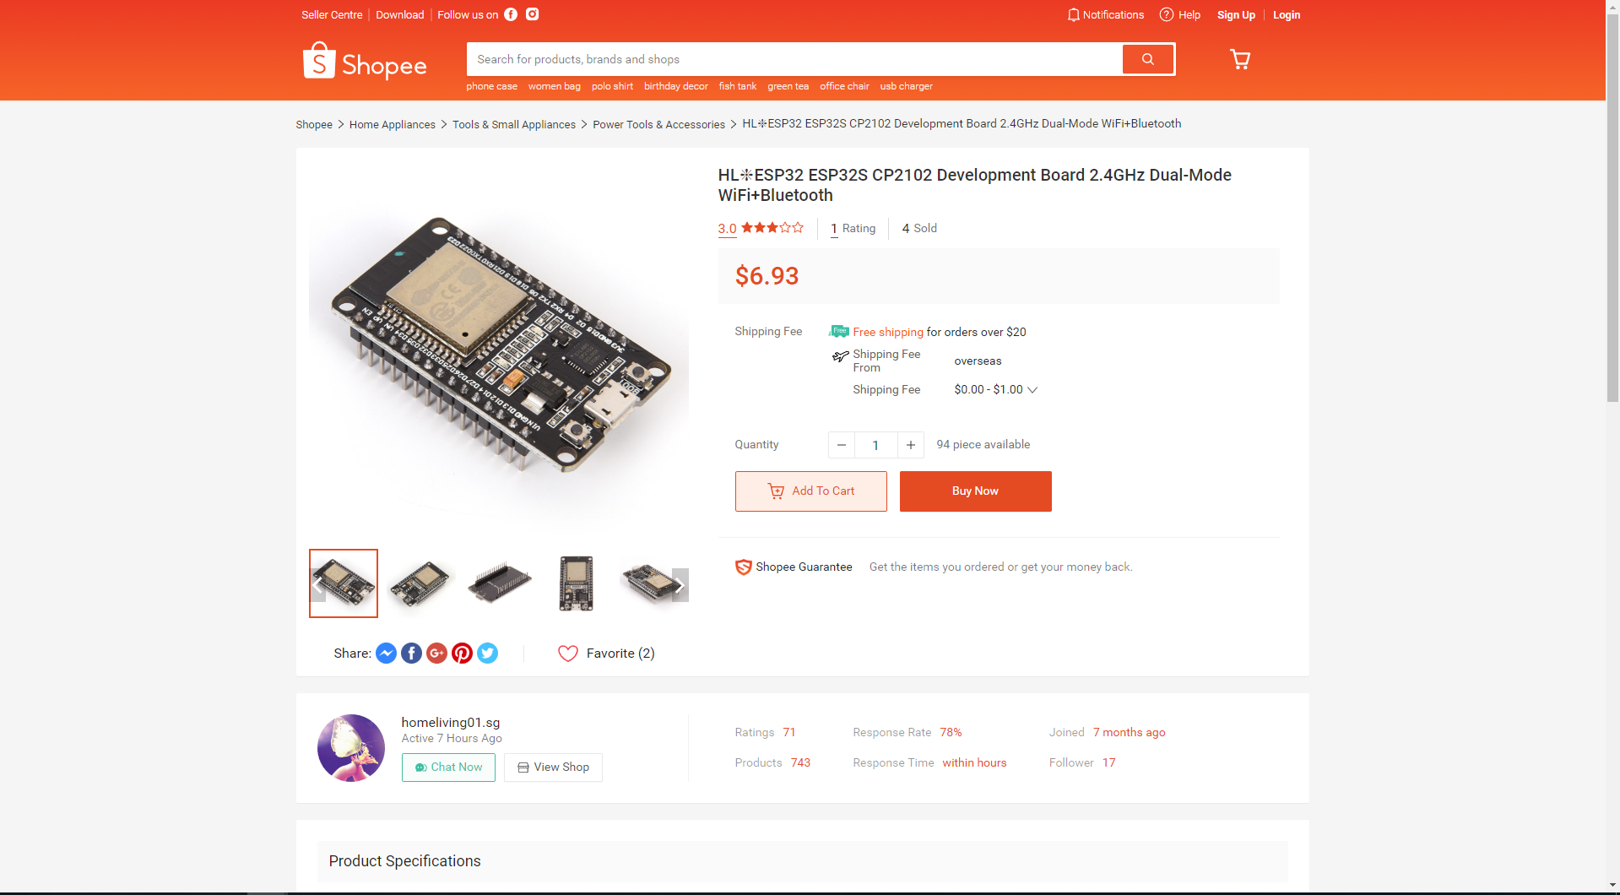

Slide 14
Demand history for past n days
Time series model
.
.
.
Demand on given day
Demand history for past n days
Demand = Food actually eaten (Total amount – Amount wasted)

Slide 15
Food type
Linear regression model
Score determining how much food type contributes to food waste
Total weight of waste

